Slide 1




Improving joy and meaning in work
(COLLECTIVE LEADERSHIP FOR TEAM PERFORMANCE)
COLLECTIVE LEADERSHIP AND
SAFETY CULTURES
HIGH RELIABILITY AT TEAM LEVEL

Slide 2
High reliability
“The unusual capacity to produce collective outcomes of a certain minimum quality repeatedly” (Hannan & Freeman, 1984)
Organisational reliability is thought to be achieved through the development of highly standardised routines.

Slide 3
Collective safety awareness
A safety aware team is willing to scrutinise perceptions and expectations to make sense of and learn from new events.
“A shared team focus on achieving high safety through an on-going effort to update and optimise routines, procedures and actions based on experience and anticipation”

Slide 4



Organisations that work in a potential high-risk environment, but perform nearly error-free.
The most efficient HROs are found in:
High Reliability Organisations (HROs)

Slide 5
Number of global deaths from aviation in 2017?
Number of deaths associated with preventable patient harm in the US each year?
399 (B3A annual review)
Uncertain, but likely between 210.000 and 400.000
(James, 2013)

Slide 6


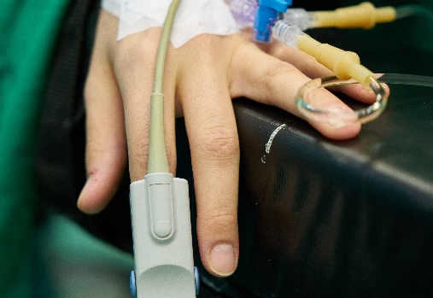
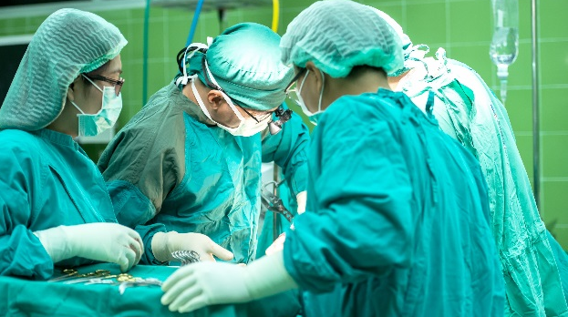
Characteristics of settings with HROs
Potential high risk environment
An unforgiving social and political environment
The scale of consequences of errors precludes learning from experience
Complex processes and procedures
(Sutcliffe 2011)

Slide 7
Reflection and discussion (2-3 min.)
Think about an incident where preventable harm either came or could have come to a patient. It can be an incident or near miss that you have been involved in or heard about at work/in the media. Consider the following:
If you were responsible for the overall patient safety for your team/department, what would you do to prevent a similar incident from happening in future?
  Be concrete! What policies, guidelines, procedures, equipment, training, etc. would you implement/change to prevent a similar incident?
Share and discuss your suggestions in groups of 2-3.

Slide 8
Characteristics of HROs
High collective safety awareness
Strive to achieve zero harm
Systems/routines in place to minimise the risk/consequences of inevitable human error
Authority patterns based on functional skill (expertise over formal rank)
Encourage the reporting of errors and make the most of any failure that is reported
  No punitive/blame culture

Slide 9
Five key processes underlie high collective safety awareness in HROs
Preoccupation with failure
Everyone is aware of, thinking about, and preparing for the potential for failure
Reluctance to simplify interpretations
People avoid simplifying their understanding of how and why things succeed or fail in their environment.
Sensitivity to operations
“Situational awareness” – awareness of context and how that may impact on safety.
Commitment to resilience
Coping with, containing, and bouncing back from mistakes.
Deference to expertise
Deference to local and situational expertise rather than formal rank.
  (Adapted from Weick, et al. 2007, Sutcliffe 2011, AHRQ 2018)

Slide 10
GROUP DISCUSSION (10 min)
The team is split into 5 groups – each group is provided with reading material about one of the key processes. Each group will discuss:
What do we do well as a team in relation to this process?
What can we improve on in relation to this process?
Groups should take notes of their discussion and prepare to explain their specific process and key discussion points to the whole team during team discussion.

Slide 11
TEAM DISCUSSION (30 min.)
For each key process, use the following structure:
  Subgroup briefly explains the process (what it is/how to achieve it)
  Subgroup feeds back their main discussion points
  Whole team to discuss:
    How do we improve in relation to this process?
      What actions can we take?
      Who will be responsible?
Preoccupation with failure
Reluctance to simplify interpretations
Sensitivity to operations
Commitment to resilience
Deference to expertise
If any time is left, try to rank the key processes 1-5 based on which processes the team needs to prioritise the most.
A team member should take notes of the discussion/fill in the Co-Lead template, paying particular attention to any concrete actions discussed/decided by the team

Slide 12
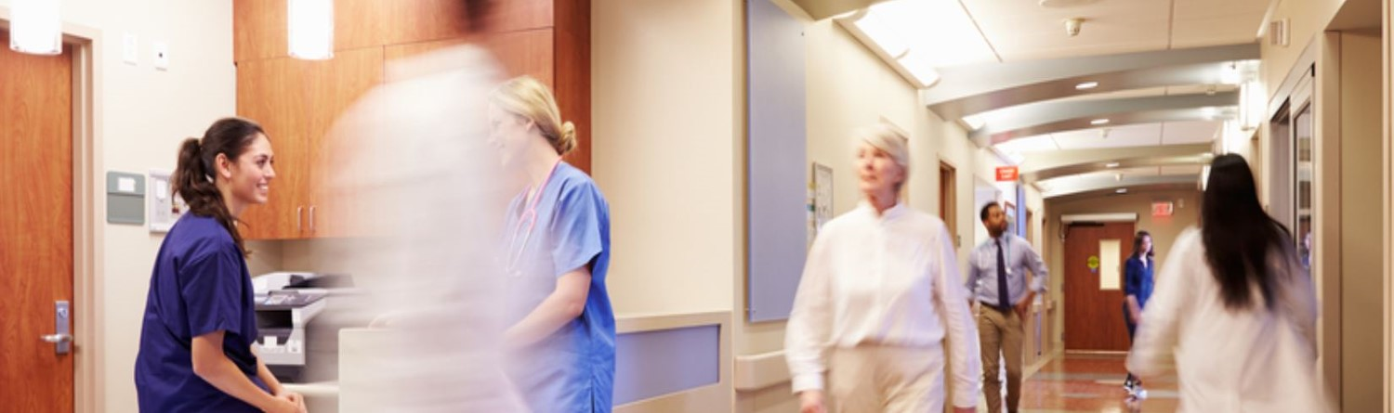
Thank you

